Slide 1

Beta 2 Demo Scorecard Refresh for SIL
Presented by:
Data Science
January 2025

Slide 2
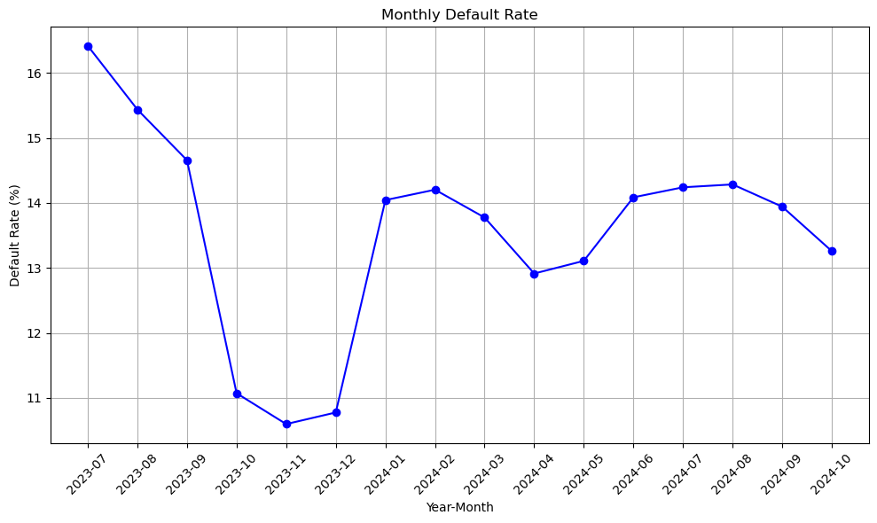
 | Loan Disbursement Date | # All SIL Loans |  |  | # Bad (FSPD30) SIL Loans |  |  | FSPD30 rate
 |  | Overall | Mobile | Non Mobile | Overall | Mobile | Non Mobile | Overall |  | Mobile | Non Mobile
All Data Training – 90%,val – 10% | 01/07/2023 - 30/06/2024 | 57408 | 3097 | 54311 | 7484.0 | 596.0 | 6888.0 | 0.1303 | 0.1924 |  | 0.1268
July | 01/07/2024 - 31/07/2024 | 11284 | 2563 | 8721 | 1607.0 | 515.0 | 1092.0 | 0.1424 | 0.2009 |  | 0.1252
Aug | 01/08/2024 - 31/07/2024 | 14287 | 4102 | 10185 | 2041.0 | 754.0 | 1287.0 | 0.1428 | 0.1838 |  | 0.1263
Sep | 01/09/2024 - 30/09/2024 | 14387 | 4284 | 10103 | 2006.0 | 810.0 | 1196.0 | 0.1394 | 0.1890 |  | 0.1183
Oct | 01/10/2024 - 25/10/2024 | 10393 | 2949 | 7444 | 1378.0 | 568.0 | 810.0 | 0.1325 | 0.1926 |  | 0.1088
SIL Loan FSPD30 rate over the months

Slide 3
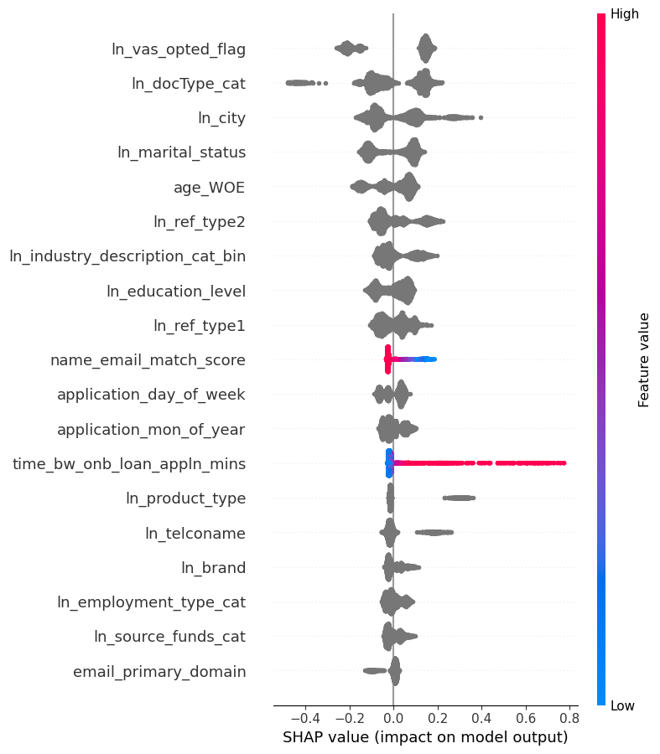
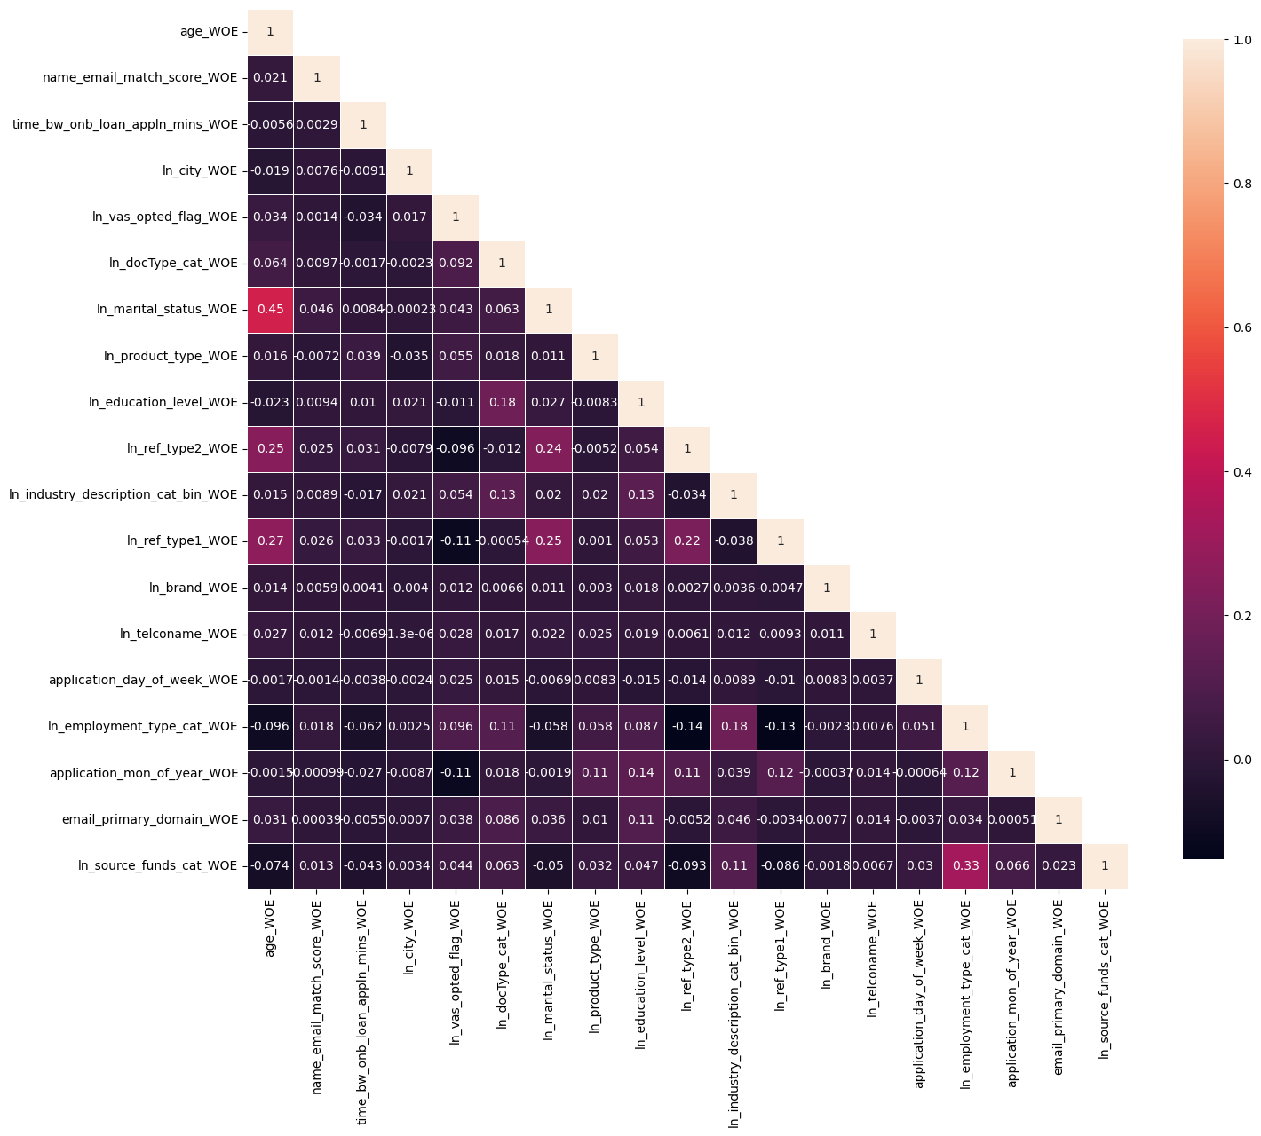
Top 19 Feature Performance

Slide 4
Top 16 Feature Description (1 of 2)
Feature Name | Feature Description
ln_vas_opted_flag | ln_ prefix means the feature is taken from Loan Journey unless the feature name is obviously from Loan Journey. This feature means whether the user has opted for any value-added services like PayHinga (that allows payment holidays) during the loan application process
ln_doc_type_cat | Type of KYC document uploaded by the customer. We aggregated similar categories into one, e.g. Driving License type 2018 and Driving License type 2022 would be combined into Driving License etc.
ln_marital_status | Marital status of the loan applicant: single/ married/ widow etc.
Age_WOE | Age of the applicant, used WOE binning for better handling of outliers
ln_city | City from the Address given during loan application
ln_education_level | Education level given during loan application
ln_ref_type2 | Every loan applicant needs to give Two References: their names, contact details and relationship with those references. This feature is the relationship type of the loan applicant with the 2nd Reference
ln_ref_type1 | This feature is the relationship type of the loan applicant with the 1st Reference
ln_industry_description_cat_bin | We used the new Industry Descriptions for this provided by Dj and Mel. Basically, in our modeling dataset we replaced the old Industry Description name with the new Industry Description name. However, there are some completely new Industry Descriptions that DJ and Mel introduced which were never there before in our dataset. During inferencing those completely new ones will get mapped into a category called 'new'. After 4-5 months we will need to retrain this model to allocate them into proper industry description bins.
application_day_of_week | Which day of week the user applied for the loan (Mon/Tue/ Wed/Thu/Fri/Sat/Sun)

Slide 5
Top 16 Feature Description (2 of 2)
Feature Name | Feature Description
ln_telconame | name of the Telco provider based on the Mobile number. Now in Loan application we do NOT ask the user to re-enter their Mobile number, but we ask them to enter one additional mobile number. This telconame is extracted from the primary mobile number given by the customer.
ln_employment_type_cat | We used the new Employment Type for this provided by Dj and Mel. Basically, in our modeling dataset we replaced the old Employment Type name with the new Employment Type name. However, there are some completely new Employment Types that DJ and Mel introduced which were never there before in our dataset. During inferencing those completely new ones will get mapped into a category called 'new'. After 4-5 months we will need to retrain this model to allocate them into proper Employment Type bins.
name_email_match_score | This feature calculated the similarity matching score between users (firstname |middlename | lastname) and the first part of their email addresses and choose the max score. Usually risky users does not give their names in their emails and vice versa. So high match score means lower risk, and low match score means higher risk.
ln_product_type | Product type of the SIL purchase. Can be one of these 3 values: Mobile/ Appliances/ Mall
ln_brand | Means the device manufacturing brand of the loan applicant. E.g. Apple/ Samsung/ Oppo etc.
time_bw_onb_to_loan_appln_mins | For SKYC users from the beginning: Time between TSA onboarding time (Customer ID creation time) and the Loan Application Submission time in mins. For BKYC users who upgraded to SKYC users: Time between BKYC to SKYC Upgrade time and the Loan Application Submission time in mins. This adjustment was done to take into account that BKYC users cannot apply for a loan, they can apply only after they are upgraded to SKYC.

Slide 6
Model Performance wrt FSPD30
 | 01/07/2023 - 30/06/2024 |  | Test (July) Gini |  |  | Test (Aug) Gini |  |  | Test (Sep) Gini |  |  | Test (Oct) Gini
 | Train Gini (90%) | Val Gini (10%) | Overall | Mobile | Non Mobile | Overall | Mobile | Non Mobile | Overall | Mobile | Non Mobile | Overall | Mobile | Non Mobile
Old Model retrained with the same features Bins (Logreg – v0) | 0.1450 | 0.1533 | 0.1350 | 0.0555 | 0.1620 | 0.1338 | 0.0778 | 0.1573 | 0.1320 | 0.0818 | 0.1660 | 0.1301 | 0.0892 | 0.1629
Retrained with same feature but changed features Bins (Logreg) – v1 (In production from December 2024) | 0.1581 | 0.1756 | 0.1289 | 0.0920 | 0.1363 | 0.1368 | 0.1123 | 0.1434 | 0.1021 | 0.0548 | 0.1281 | 0.1052 | 0.1027 | 0.1082
Current 19 feat Model (Catboost) – v2 | 0.3747 | 0.2825 | 0.2979 | 0.2155 | 0.2945 | 0.2721 | 0.2083 | 0.2704 | 0.2980 | 0.1811 | 0.3095 | 0.3105 | 0.2060 | 0.3072
Current 18 feat Model (Catboost) – v2.1 (wihout the SIL Product type feature) | 0.3714 | 0.2780 | 0.2687 | 0.2110 | 0.2925 | 0.2504 | 0.2136 | 0.2710 | 0.2681 | 0.1803 | 0.3125 | 0.2740 | 0.1997 | 0.3078

Slide 7
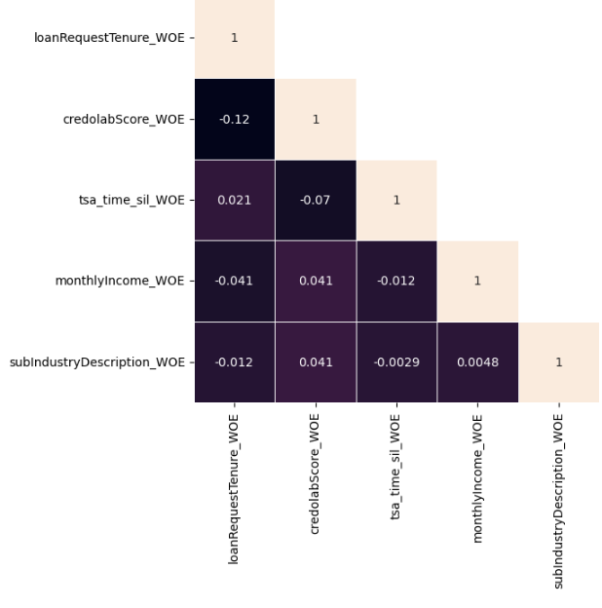
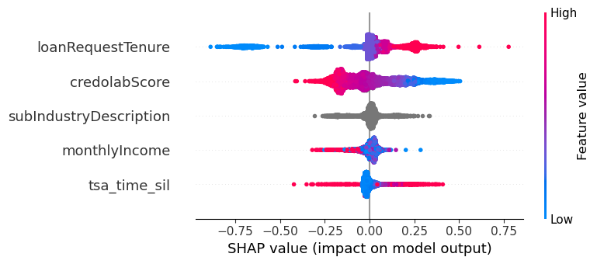
For your Reference: Retrained with changed features Bins (Logreg) – v1 (In production since December 2024)

Slide 8
Appendix

Slide 9
Model Performance wrt FSPD30
Old Calculation, for reference purpose only
 | 01/07/2023 - 30/06/2024 |  | Test (July) Gini |  |  | Test (Aug) Gini |  |  | Test (Sep) Gini |  |  | Test (Oct) Gini
 | Train Gini (90%) | Val Gini (10%) | Overall | Mobile | Non Mobile | Overall | Mobile | Non Mobile | Overall | Mobile | Non Mobile | Overall | Mobile | Non Mobile
Old Model retrained with the same features Bins (Logreg – v0) | 0.1450 | 0.1533 | 0.1350 | 0.0555 | 0.1620 | 0.1338 | 0.0778 | 0.1573 | 0.1320 | 0.0818 | 0.1660 | 0.1301 | 0.0892 | 0.1629
Retrained with same feature but changed features Bins (Logreg) – v1 (In production from December 2024) | 0.1581 | 0.1756 | 0.1289 | 0.0920 | 0.1363 | 0.1368 | 0.1123 | 0.1434 | 0.1021 | 0.0548 | 0.1281 | 0.1052 | 0.1027 | 0.1082
Current 19 feat Model (Catboost) – v2 | 0.3747 | 0.2825 | 0.2979 | 0.2155 | 0.2945 | 0.2721 | 0.2083 | 0.2704 | 0.2980 | 0.1811 | 0.3095 | 0.3105 | 0.2060 | 0.3072
Current 18 feat Model (Catboost) – v2.1 (wihout the SIL Product type feature) | 0.3714 | 0.2780 | 0.2687 | 0.2110 | 0.2925 | 0.2504 | 0.2136 | 0.2710 | 0.2681 | 0.1803 | 0.3125 | 0.2740 | 0.1997 | 0.3078

